Slide 1

Cancer Detection using Machine-Learning
To know about the symptoms of cancer by this prediction!!!
180060010 Pradeep
180050094 Pavan
180050095 JasHwanth

Slide 2
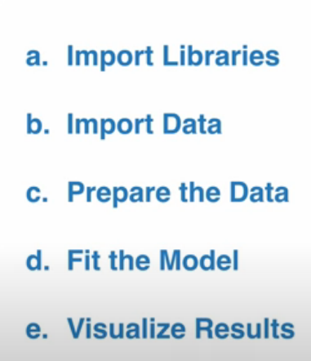
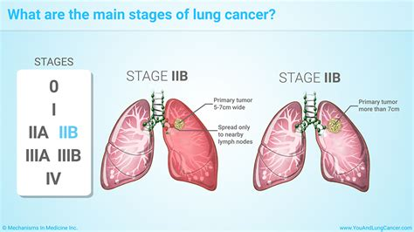
Introduction to SVM
Needed libraries
Data sets
Reason of our project
Data analysis on datasets
Preparing the model
RESULTS
Process of Project work-flow:

Slide 3
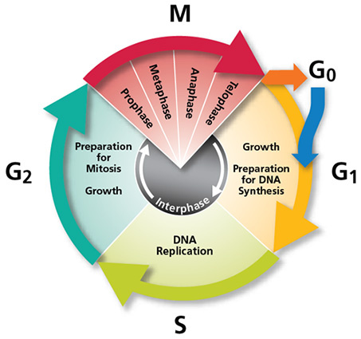
JOURNEY of EVERY CELL-CYCLE

Slide 4
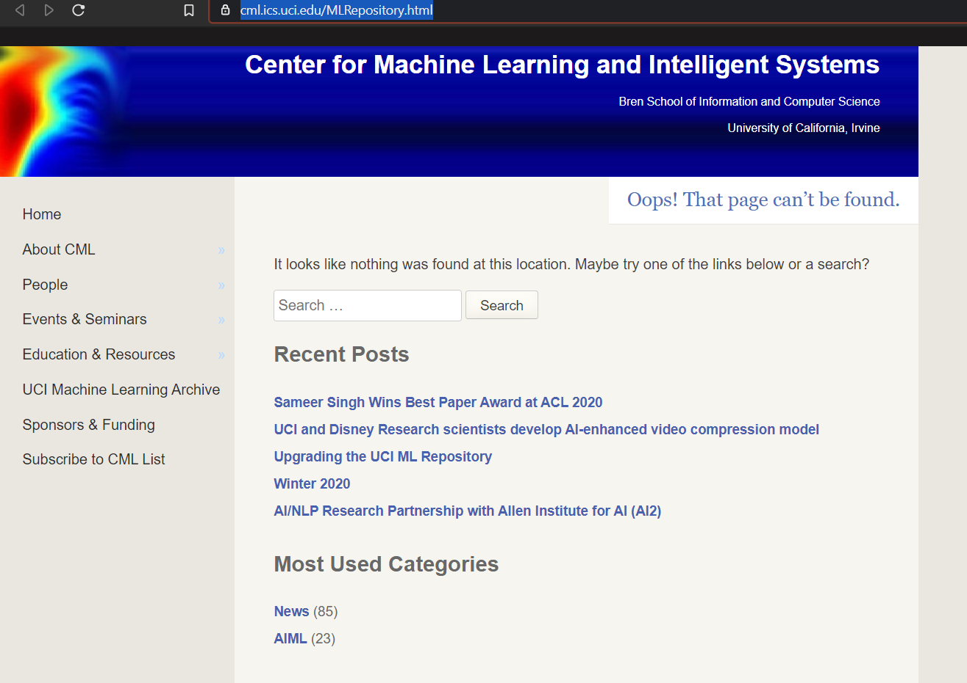
Data sets collected from:

Slide 5

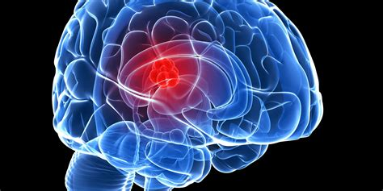
What is CANCER ??
Cancer is a group of diseases involving abnormal cell growth with the potential to invade or spread to other parts of the body.
How to predict that cancer ??
Size is about 2micro meters

Slide 6
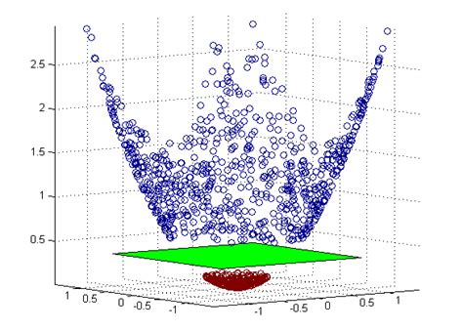
What is SVM ??
Support Vector Machines are a type of supervised machine learning algorithm that provides analysis of data for classification and regression analysis.
USING :-
Support Vector machines

Slide 7
What is the function ?? Used here
KERNELS are the functions used here
In SVM algorithm we use a set of mathematical functions called as the kernel.

Slide 8
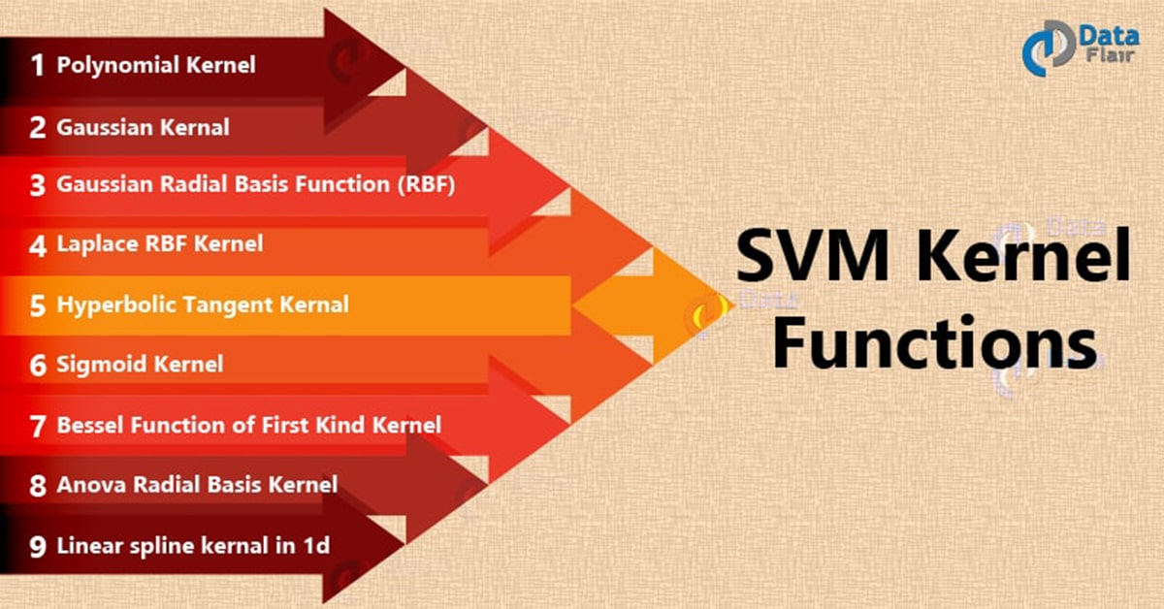

Slide 9
Features considered: ( per few drops of / blood sample)
No. of abnormal Chromosomes
No.of Blood cells that are deviated in shape
goblet cell carcinoid content
low-grade mucinous neoplasm of the appendix (LAMN)
high-grade mucinous neoplasm of the appendix (HAMN)
No. Clumps (blocks in the skin)
adenocarcinoma: signet ring cell

Slide 10
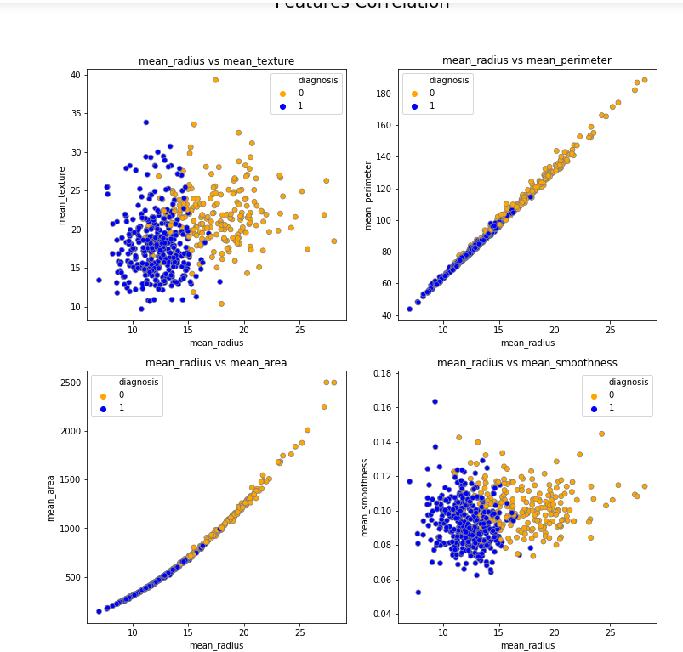
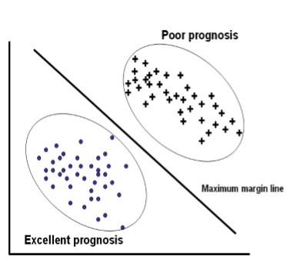
Our prediction strategy:

Slide 11
RESULT TRYING TO FIND:
To know about the symptoms of cancer by this prediction !!!
Because, PREDICTION is BETTER than CURE

